Slide 1
Digital Electronics and Systems
Topic: Karnaugh Map

Slide 2
Karnaugh Map ( K-Map)
K-Map is an alternate technique for minimizing Boolean expressions.
It contain boxes called cells.
No: of cells = 2^{n} , where ‘n’ is the number of variables.
Thus a 2-variable map contains 4 cells, 3-variable map contains 8 cells and so forth.

Slide 3
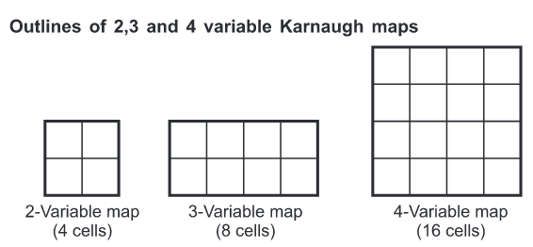

Slide 4
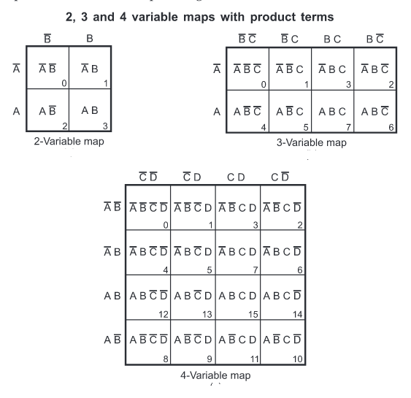

Slide 5
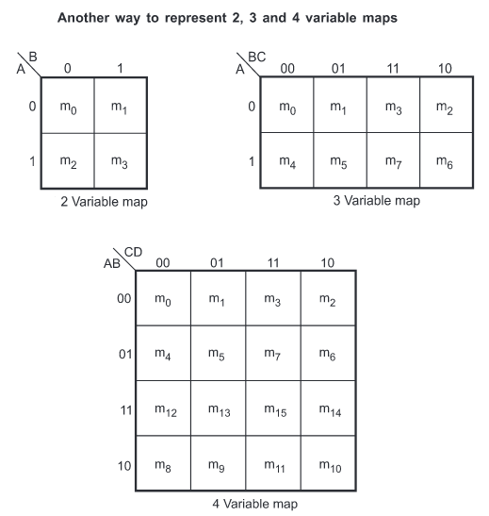

Slide 6
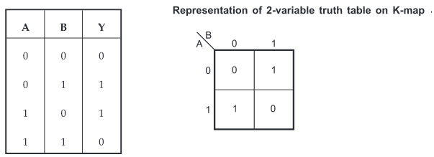
Representation of truth table on Karnaugh map

Slide 7
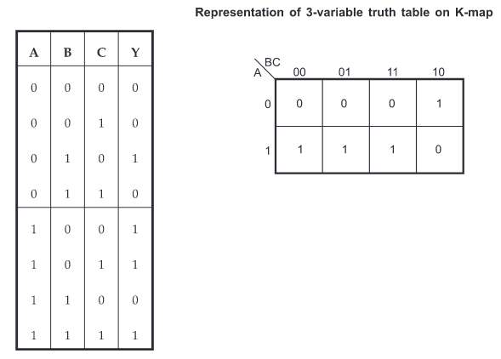

Slide 8
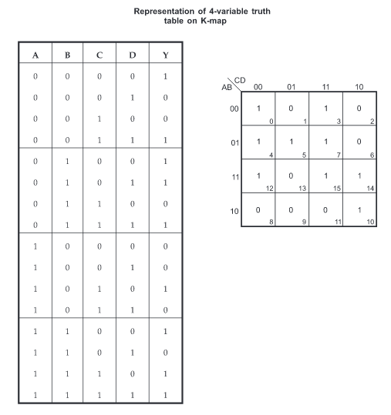

Slide 9
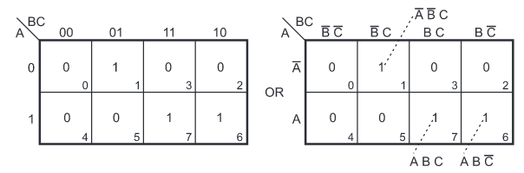
Representing standard SOP on Karnaugh map

Slide 10
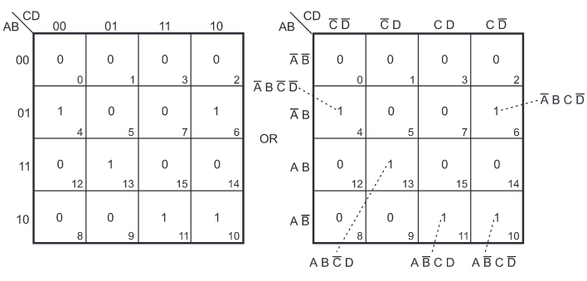

Slide 11
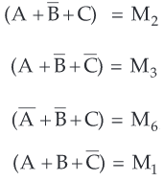
Representing standard POS on Karnaugh map

Slide 12
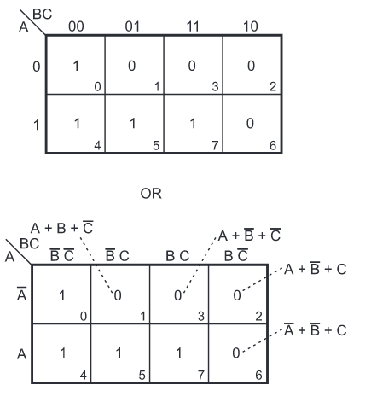

Slide 13
Grouping cells for simplification
Grouping is combining adjacent cells.
Two cells are said to adjacent if they confirm single change rule.
The simplification is achieved by grouping adjacent 1’s or 0’s.
When adjacent 1’s are grouped, then we get result in the sum of products form.
When adjacent 0’s are grouped, then we get result in the product of sum form.

Slide 14
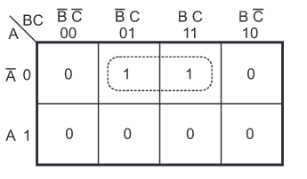
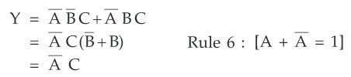
Grouping two adjacent ones (pair)

Slide 15
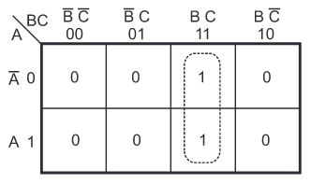


Slide 16
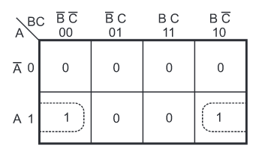

In a Karnaugh map the left most column and right most columns are considered to be adjacent

Slide 17
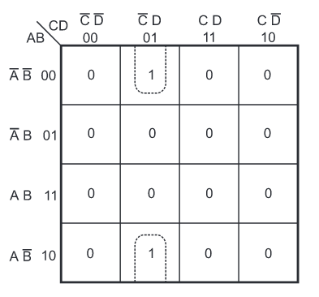


Slide 18
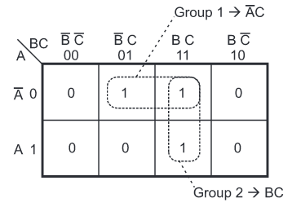
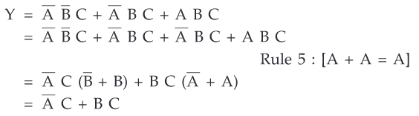

Slide 19
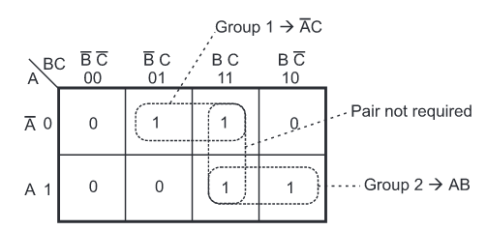


Slide 20
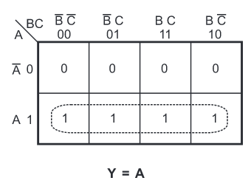
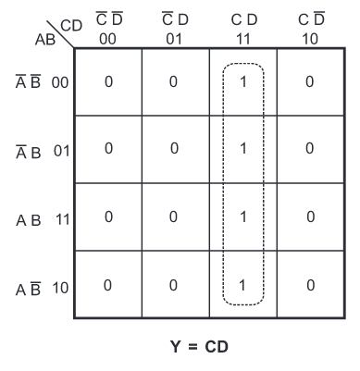
Grouping 4 adjacent ones (Quad)

Slide 21
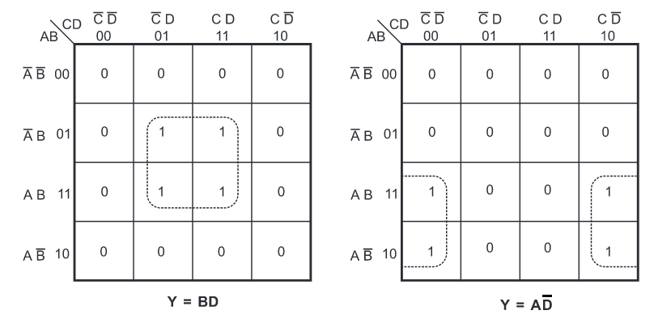

Slide 22
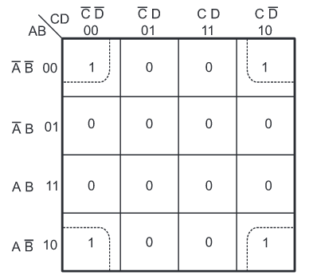


Slide 23
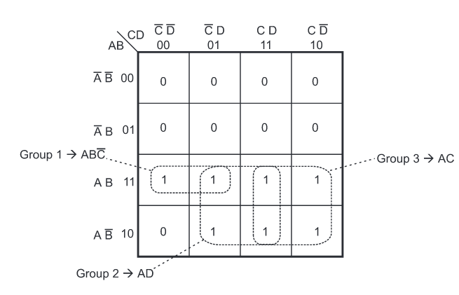

Slide 24
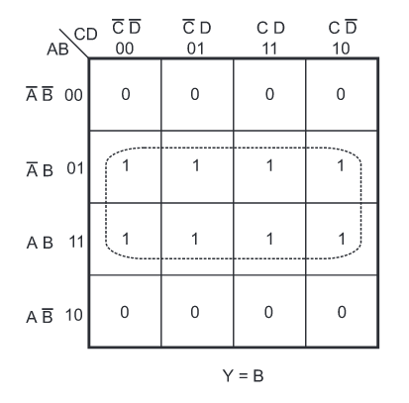
Grouping 8 adjacent ones (Octet)

Slide 25
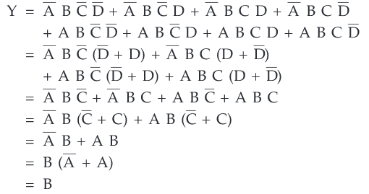

Slide 26
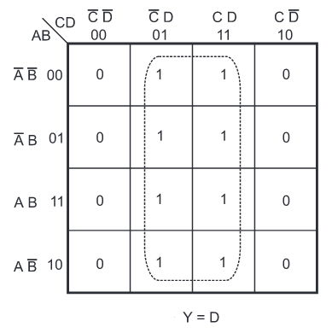

Slide 27
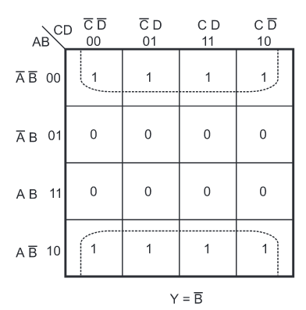

Slide 28
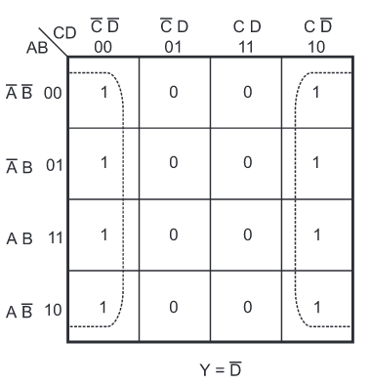

Slide 29
A group of two eliminates 1 variable.
A group of four eliminates 2 variables.
A group of eight eliminates 3 variables.

